Slide 1
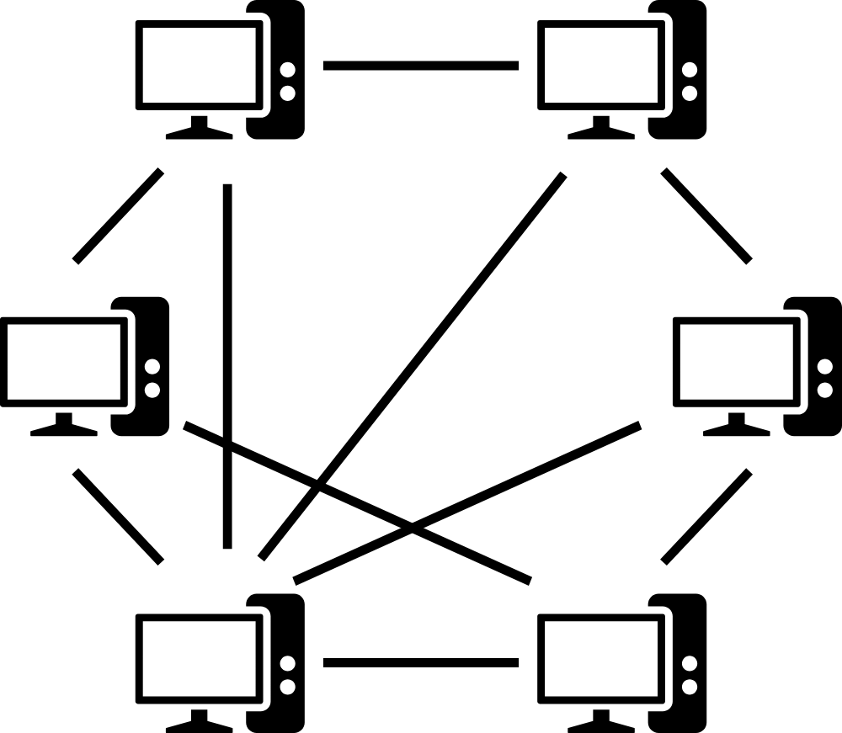
Novel Peer to Peer Gambling System
Jacob Wyngaard

Slide 2
My Goals
Provide overview of Synthesized Speculation Gambling System
Compare to traditional money line system
Discuss pros and cons of implementation
Discuss the possibility of implementation with Prophet Exchange

Slide 3

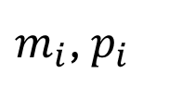
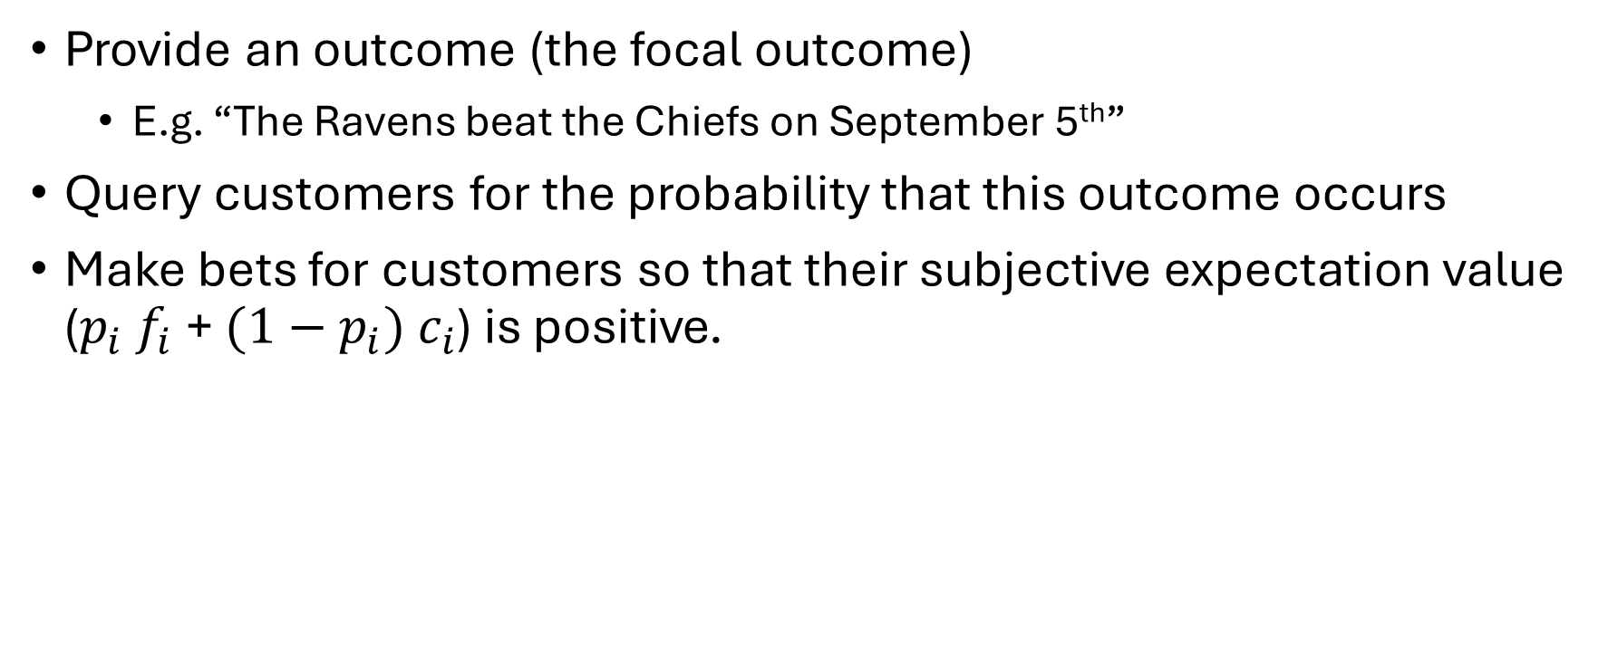
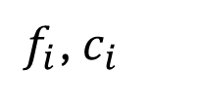
General Idea
Provide an outcome (the focal outcome)
E.g. “The Ravens beat the Chiefs on September 5th”
Query customers for the probability that this outcome occurs
Make bets for customers so that their subjective expectation value ($p_{i} f_{i}$+ ${(1−p}_{i}) c_{i}$) is positive.
$m_{i}$, $p_{i}$
$f_{i}$, $c_{i}$
$f_{i}$ - monetary result if focal outcome occurs
$c_{i}$ - monetary result if focal outcome doesn’t occur

Slide 4
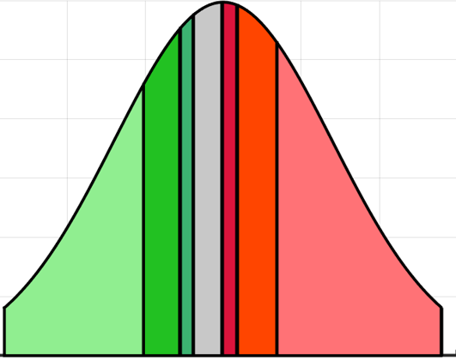
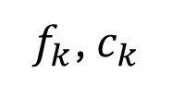

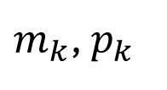
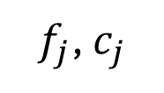

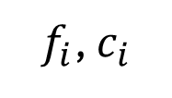

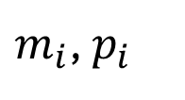

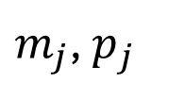

Synthesized Speculation Gambling System
Black Box Architecture
(to Users)
Bet Slicing
$m_{k}$, $p_{k}$
$$m_{i}$$
$m_{j}$, $p_{j}$
Winning Condition
Peer Bet
$$\$5$$
Stake
Payout
$m_{i}$, $p_{i}$
Peer Bet
Winning Condition
$$\$5$$
Stake
$$…$$
Payout
Remaining Slice
Peer Bet
Winning Condition
$$\$5$$
Stake
Payout
Peer Bets
Change
$f_{i}$, $c_{i}$
$f_{j}$, $c_{j}$
$f_{k}$, $c_{k}$
Iterative Money Line
Money Line Positions
For Every Player
Winning Condition
Stake
Payout

Slide 5
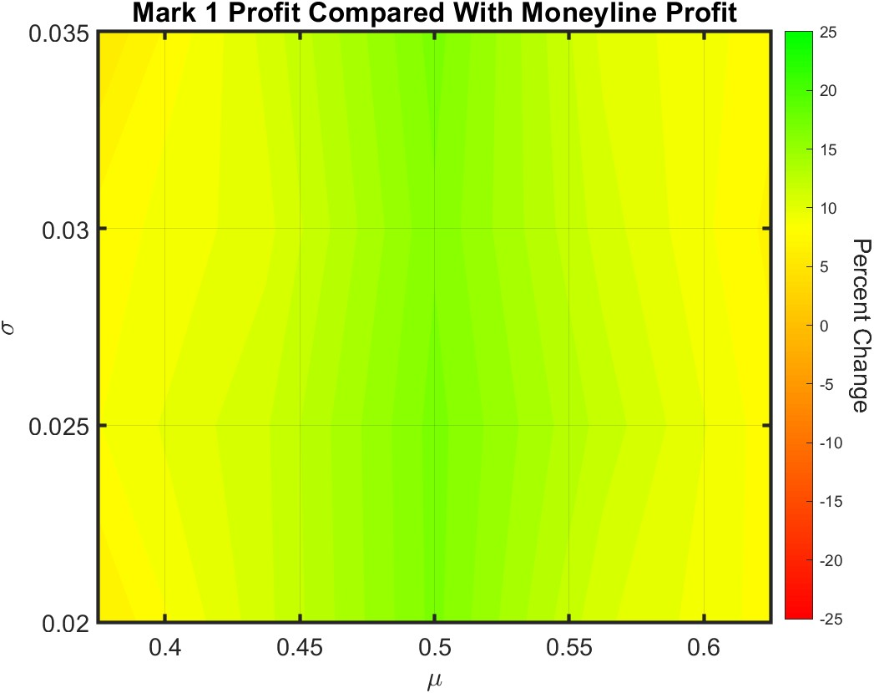
Comparison With Traditional Money Line
Profit increase ranges from 5% to 17% across sample subjective probability distributions
Note: Money line results solved for by estimating the distribution of subjective probability and solving for money line that maximized profit under the constraint of balance

Slide 6
Pros and Cons
Pros
Cons
Balanced Outcomes
High Start-Up Costs
Higher profit than money line* or betting exchange
Users lose ability to choose winning condition
Potential to market as a way to demonstrate one’s intelligence
*Under several assumptions regarding subjective profitability and rationality

Slide 7
Potential Implementation
I recommend a beta version with faux currency, with prizes given the most successful users at the end of testing.
Legalization required

